Slide 1
IoT ENHANCED LOAD MANAGEMENT FOR OPTIMAL ENERGY UTILIZATION
JAYAKRISHNAA. S 21E908
KANI BRAMA GIRI. S 21E911 KOVARTHANAN. K 21E914 PALAPARTHI TARUN 21E918
SUBASH. A 21E922

Slide 2
INTRODUCTION
The IoT (Internet of Things ) has revolutionized the way we interact and manage our surroundings, offering unprecedented connectivity and control over various aspects of our daily lives.
In the realm of energy consumption and sustainability, IoT has emerged as a powerful tool for enhancing load management and optimizing energy utilization.
This paradigm shift in energy management promises to not only
Increase efficiency
but also reduce costs
minimize environmental impact,
and improve the overall quality of life.

Slide 3
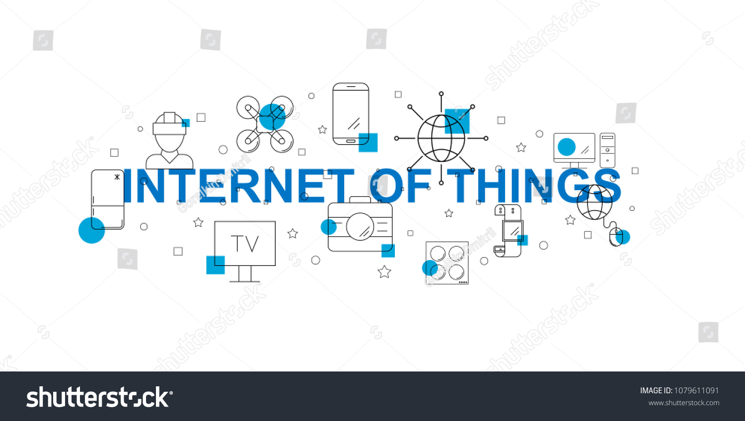
INTRODUCTION
In industrial , commercial facilities, or residential homes, the ability to collect, analyze, and act upon data from a myriad of interconnected devices and sensors has opened up new possibilities for intelligent load management. This comprehensive approach allows for precise control and optimization of energy usage, ensuring that resources are allocated where they are needed most, at the right time.

Slide 4
EXISTING SYSTEM
In an era characterized by increasing energy costs and a growing emphasis on sustainability, there exists a pressing need for a robust and user-friendly energy management system. Many consumers face challenges in optimizing their energy usage, reducing wastage, and aligning their energy consumption with their daily routines. To address this issue, we aim to design and implement an innovative energy management system that empowers users to remotely control and monitor electrical devices through a smartphone application.

Slide 5
PROPOSED SYSTEM
This innovative system will serve as a solution to the challenges consumers face in managing their energy use.
It will enable users to control their devices from afar, turning them on or off at specific times, and obtain real-time data about their energy consumption.
By leveraging Time-Of-Day considerations, this system can automatically adjust energy consumption patterns based on the Time-Of-Day and the user's preferences.
For instance, it can schedule certain devices to operate during off-peak hours when energy costs are lower, leading to potential cost savings.
This system not only enhances convenience but also supports sustainability efforts by promoting energy efficiency and reduced wastage.

Slide 6
It empowers users to make informed decisions about their energy consumption, aligning with the broader goals of cost-effectiveness and environmental responsibility in today's energy landscape.
This system not only enhances convenience but also supports sustainability efforts by promoting energy efficiency and reduced wastage.
It empowers users to make informed decisions about their energy consumption, aligning with the broader goals of cost-effectiveness and environmental responsibility in today's energy landscape.
Our System Includes:
1.Manual control
2.Control based on Temperature
3. Control based on Real Time Clock(RTL)

Slide 7
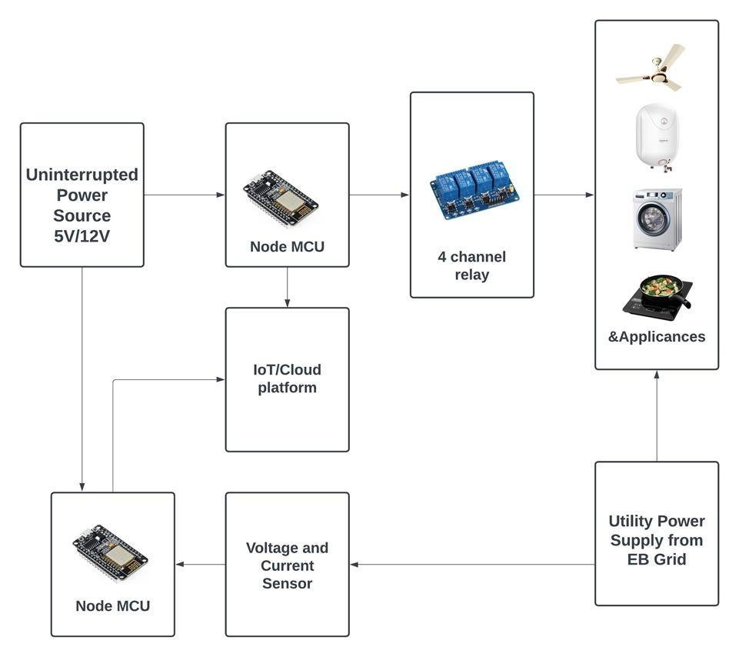
BLOCK DIAGRAM

Slide 8
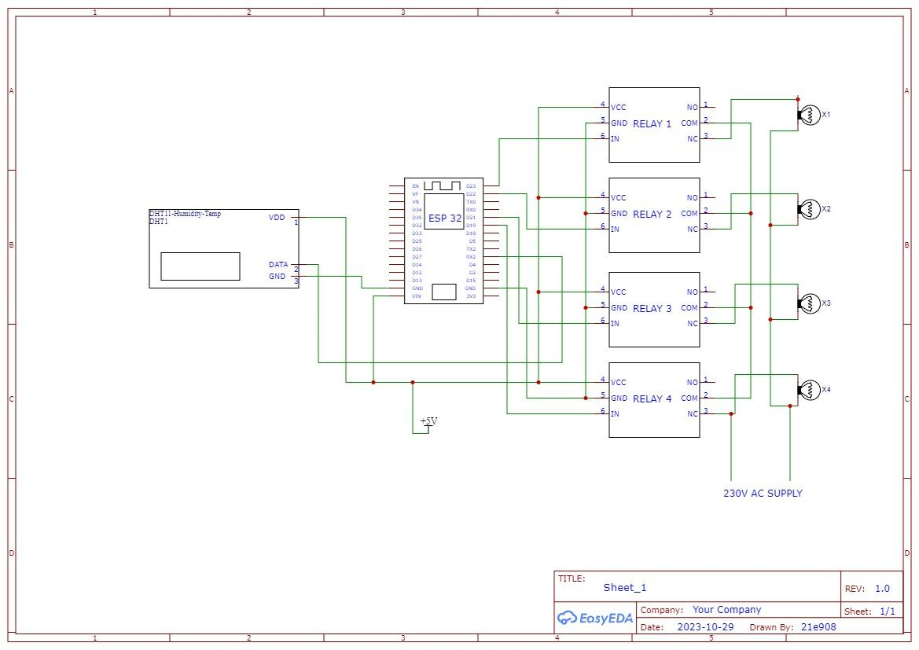
CIRCUIT DIAGRAM

Slide 9
ALGORITHM
Step 1: Start the Program
Step 2: Initialising Wi-Fi connection to ESP32
Step 3: ESP32 links with Blynk IoT cloud
Step 4: When the Data stream 1 is turned on in the app, relay 1 turns on
Step 5: When the Data stream 2 is turned on in the app, relay 2 turns on
Step 6: Temperature sensor checks for ambient temperature, when the temperature is greater
than 20 Degree Celsius relay 3 automatically turns on, if less than 20 Degree Celsius
relay 3 remains off
Step 7: When the Real Time Clock (RTC) reaches the programmed time, relay 4 automatically
turns on and turns off at the programmed time
Step 8: End
(*Note: The steps 3 to 6 are simultaneous process)

Slide 10
SOFTWARE DEVELOPMENT
Libraries used
WiFi.h
BlynkSimpleEsp32.h
DHT.h
Functioning of the Program
Setting up Blynk:
Hardware Initialization:
Handling Blynk Inputs
Monitoring Blynk Connection:
Sensor Data Collection:

Slide 11
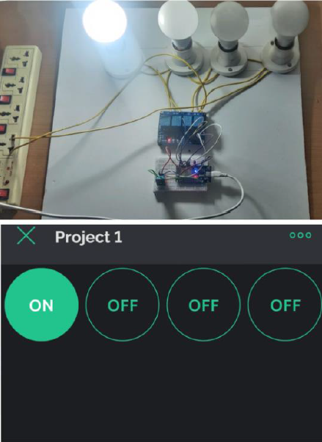
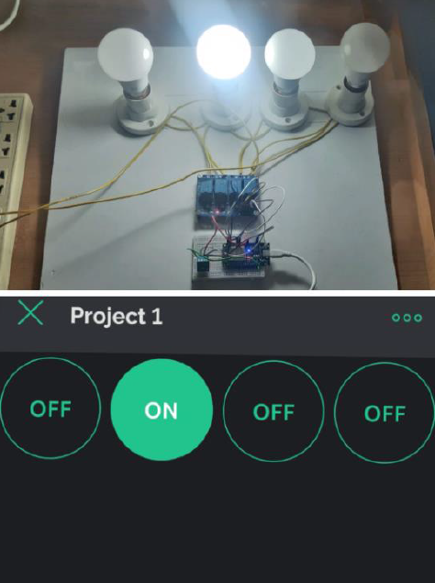
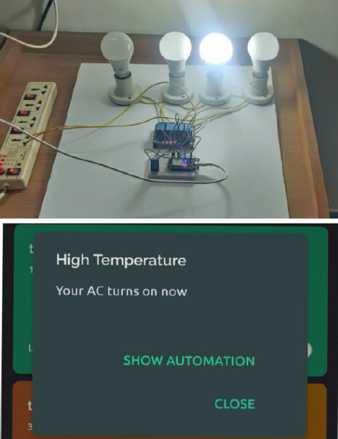
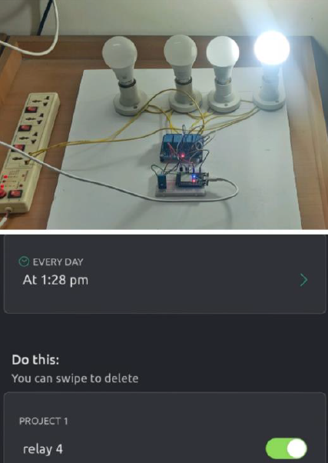
RESULT

Slide 12
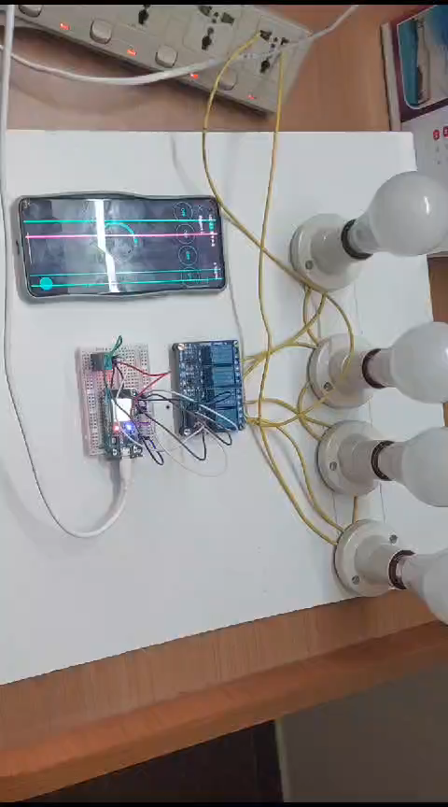
OUTPUT VIDEO

